Slide 1
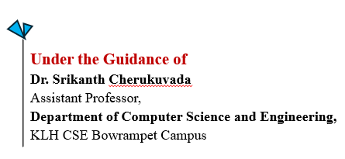
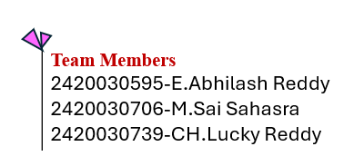
WeatherGuardian AI: An Agentic and Service-Oriented Framework for Intelligent Weather Advisory Management
Project Review-2

Slide 2
Methodology
Weather Data Collection: Real-time weather data is collected from external weather APIs and processed by the Weather Data Service.
Risk Analysis: The collected data is analyzed to identify potential risks such as heavy rainfall, extreme heat, storms, and strong winds.
AI Advisory Generation: The analyzed weather conditions are processed by the AI Advisory Service to generate meaningful and actionable recommendations.
Adaptive Agentic Mechanism: The system continuously responds to changing weather conditions and updates recommendations accordingly.
Forecast & Notifications: Forecast information is provided, while critical weather conditions trigger timely alerts and notifications.
SOA-Based Integration: Independent and reusable services communicate through RESTful APIs, making the system flexible, scalable, and maintainable.

Slide 3
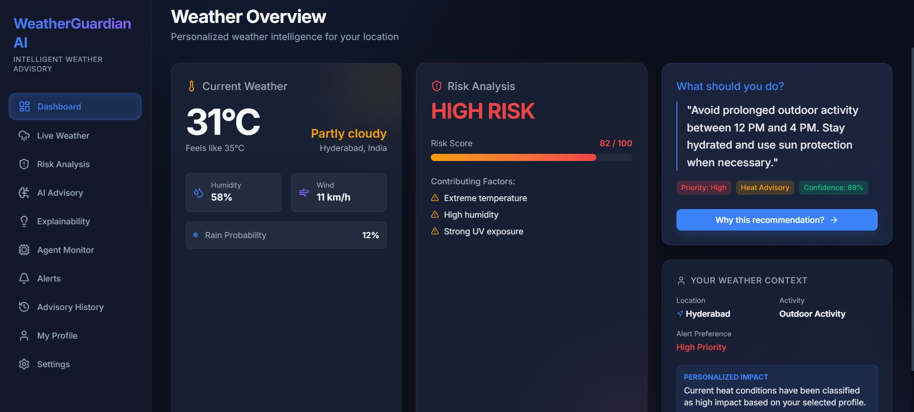
Result

Slide 4
Base Paper
Title: Explainable AI-Based Interface System for Weather Forecasting Model
Authors: Soyeon Kim et al.
Year: 2025
Methodology:
Uses a deep-learning precipitation forecasting model (UNet2) for short-term rainfall prediction.
Applies User-Centered Explainable AI (XAI) to make weather predictions understandable.
Uses feature attribution to explain the model's reasoning.
Uses probability calibration to show prediction confidence.
Provides an interactive XAI interface based on user feedback.
Key Findings:
XAI explanations improved user trust and decision utility.
Users preferred simple and intuitive explanations.
The system demonstrated the importance of user-centered design in weather AI.
Limitations / Research Gap:
Focuses mainly on rainfall forecasting and explanation, not complete weather advisory management.
Feature-attribution explanations can be difficult for users to understand.
The interface has limited interaction and does not provide high-level conversational interaction.
Larger and multimodal datasets are suggested for future improvement.
How Our Project Extends It:
Our WeatherGuardian AI extends explainable weather prediction into an integrated advisory system by combining real-time weather data, risk detection, AI-generated recommendations, notifications, adaptive/agentic decision-making, and SOA-based services.

